Slide 1

Report writing & Critical thinking PROJ324/325
Dr Jason Truscott
Student Learning Services
Notes:
This video will take you through the process of writing critically for science and engineering

Slide 2


We can help with:
writing and presenting
developing thinking
using literature critically
managing projects
articulating knowledge
communicating ideas
preparing for exams and assessment

Slide 3


The ‘Digital’ Writing Café
Drop in (no booking!)
1pm – 4pm Mon-Fri (Semester time)
Via Zoom
Student writing mentors – breakout rooms
www.plymouth.ac.uk/learn

Slide 4


Open Hours
with Jason
Study skills advice
Science and Engineering
Tuesday 10am to 12noon
Drop in for a chat
liveplymouthac.sharepoint.com/sites/x77
Select ‘Open Hours for study advice’
Zoom (virtual)

Slide 5


Further details here:
www.plymouth.ac.uk/learn – External (anyone)
https://liveplymouthac.sharepoint.com/sites/x77 – Internal (Your UoP login)
Notes:
writing support 12 – 4 pm, Mon - Fri
Info: www.plymouth.ac.uk/learn

Slide 6

Free-writing
What do YOU think are the most important elements of report writing?
No rules just write
3 minutes on the above question
Overcomes writers block
Then how did it go?
Notes:
TASK for students (students already writing their essay): What challenges have you anticipated for your literature review / essay? Discussion on what they might be…Collect a mind map.
E.g. how to organise things, how to reference, how to be critical. Hopefully this workshop will help you overcome these concerns, we will be covering most here. And we also have guides to refer to later. The point of today is to demonstrate that if you can write critically, you can write academically!

Slide 7

A closer look at academic writing (Report writing)

Slide 8
What is the most important aspect of academic writing (and practice)?

Slide 9
Critical thinking
This is the foundation of academic writing. Critical thinking can be linked to practice.
Description
What?
Analysis
Why?
Evaluation
So what?
Who?
When?
Where?
How?
What if?
What next?
Notes:
Critical thinking, and making points in your writing.

Slide 10
Thinking critically
Description
Analysis
Where?
Why?
Point ‘X’
Who?
Topic
How?
When?
What if?
What?
What next?
So what?
Evaluation
Notes:
This same process that a script writer would use to create a fully rounded story is EXACTLY what you need to use when reviewing your topic.

Slide 11
Typical academic writing
Each point in the discussion has:
Critical thinking
Points move logically
Discussion
Conclusions
Point 2
Point 3
Introduction
Point 1
Notes:
The important part to remember is that each point includes critical thinking (Describe, Analyse, Evaluate) you may compare and contrast with other ideas or you may argue that a new approach is required.

Slide 12
Title: A typical example of academic writing
Introduction
First sentence relates to title and has a ‘hook’ to keep reader interested.
Background
Say what points will be discussed.
Predominantly future tense. E.g. ‘The following will be discussed…’
Discussion
Discuss those points in the same order…
Point 1 – Describe, analyse & evaluate.
Point 2 – Describe, analyse & evaluate.
Cont. – Describe, analyse & evaluate.
Ensure logical flow of ideas
Conclusions
Are a summary of the evaluations!
Don’t add anything new.
Write mainly in past tense. E.g. ‘It was found’.
Notes:
I appreciate that layouts will vary, and if you are doing a research proposal or literature review there were be different sub heading. Use the critical thinking model
However, the important elements to grasp are what is needed in order to write academically.
You need to set the scene, and say what will be discussed – any introduction needs this.
You then ensure that the points you said would be discussed are discussed with critical thinking. In the 3rd year you will be focusing more on the analysis and evaluation, that is what will yield the most marks!
The conclusions are a summary of those evaluations you made in the discussion. So if you did your critical thinking properly, you already have the basis for your conclusions!
Of course you should also include a reference section, and use references to support your arguments.

Slide 13
Deconstructing report writing
Academic/report writing is writing…
…With a few additional rules
Notes:
Who has written a play, a poem, an email?
Then you already know about writing.
The skills you need for writing your essay are not far off from writing a script or visual story.

Slide 14
Differences between reports and essays
Reports are: | Essays are:
Formally structured Informative and fact-based Written with a specific purpose and reader in mind Written in a style appropriate to each section Always include section headings Sometimes use bullet points Often include tables or graphs Offer recommendations for action | Semi-structured Argumentative and idea-based Not written with a specific reader in mind Written in single narrative style throughout Usually do not include sub-headings Usually do not include bullet points Rarely include tables or graphs Offer conclusions about a question
Learnhigher (2012) What’s The Different Between Reports And Essays? http://www.learnhigher.ac.uk/writing-for-university/report-writing/whats-the-different-between-reports-and-essays/ (Accessed: 08/02/2018)

Slide 15
Third person
Are you familiar?
Notes:
Avoid the used of first person such as ‘I’ and ‘me’…
Rather than ‘I found the following…’ in third person you would writing: ‘The following was found…’

Slide 16
What is required for the assignment?
Project handbook!

Slide 17
Understanding the brief or creating a title
Analyse two key areas of …engineering and critically evaluate the impact it has on …
T.A.P. model: Topics, Actions, Parameters
Additional parameters:
What else do you need? …Word count, font size, use of table and figures, preferred reference style? Etc …Look at your Project Handbook and marking benchmark!
N.B. The project handbook has report styling requirements
Notes:
1) Before we get onto those rules for academic writing, lets just look at how you would start to prepare your topic.
Consider the TAP model in breaking down this process:
T is for Topics – the central or key theme
A is Actions – what you need to do
P is Parameters – what limitations
The TAP model is described in more detail in our guide on Writing essays: www.plymouth.ac.uk/learn
Once you have understood your brief, you can start reviewing your materials - This is the part that takes the most work but will lead to the greatest rewards.
It does not really matter what your material is, it could be a series of documents or sources on the topic you have been given. Or it could be a specific resource that you have been asked to review. The important thing is to start capturing your ideas about the source or sources.
Consider how you will incorporate this into your word count 1500 words – short essays would mean limiting your focus on specifics. Larger bodies of writing allow you to explore other related ideas.

Slide 18
Good presentation (title page)
My engineering project title
J. Bloggs
Beng. EEE
May 2018
Plym Uni
My engineering project title
A report submitted towards the award of BEng degree in Electronic Engineering
J. Bloggs
Student no. xxxxxxxxxx
School of Computing,
Electronics & Mathematics
University of Plymouth
May 2018
Examples only
Bad presentation and formatting!
‘cannot be bothered’ first impression
Better!
N.B. A standard title-page format can be found on student projects management site (SPMS).
Please only put your name and student number on the Title Page for anonymous marking

Slide 19
Title page: Typical scientific/technical report
Summary (Abstract)
Acknowledgments - thanks or recognition
Table of contents
Glossary of acronyms/abbreviations
Introduction (Sets scene: project aims, objectives and background)
Main body
2.1 Discussions about 1st topic:
Describe, analyse and evaluate
2.2 Discussions about 2nd topic: Describe, analyse and evaluate
2.3 Discussions etc…..
Conclusions
Are a summary of the evaluations
Recommendations
Can also be drawn from evaluations
References (sources that are used in the main text)
Bibliography (Sources read but not used in text)
Appendix/Appendices

Slide 20
Report writing (numbered)
Tend to be a numbered format:
1.0 Introduction
1.1 …
1.2 …
2.0 Main Body (contain topics of discussion)
2.1 Subsection to 2.0
2.1.1 Subsection to 2.1
3.0 Main body topic 2
4.0 Main body topic 3
5.0 Conclusions
6.0 Recommendations (not always needed)
References
Appendices
This is a simplified example – check your brief! (Project handbook is written like a report)
Notes:
The headings provided here are examples, this varies and depends on the brief or student handbook!

Slide 21
What should I write?
1.0 Introduction
1.1 - What you will discuss, and why
2.0 Main body topic (Point): Describe, analyse & evaluate
Mention points in order (as per introduction) Use critical thinking!
3.0 Main body topic (Point): Describe, analyse & evaluate
3.1 – New topic (Point): Describe, analyse & evaluate
This is a simplified example – check your brief! (Project handbook is written like a report)
Notes:
Introductions - in reports are typically a little shorter than essays around 10% (but do check with your tutors or student handbook)
Discussions - contain the bulk of the text and definitely need critical thinking.
Conclusions – This is a summary of your evaluations!
Recommendations – what do you recommend?

Slide 22
Main body
Sections of main body can be broken down further:
2. Ultra-bright LEDs development
2.1 Title about a subsection to 2
3. Low power applications for Ultra-bright LEDs
3.1 Title about a subsection to 3
3.1.1 further breakdown of 3.1
However, these sections MUST include some discussion, not just bare facts.

Slide 23
What should I write?
4.0 Conclusions
4.1 These are a summary of the evaluations from discussion that are not recommendations
4.1.1 - DO NOT add anything new…
5.0 Recommendations
5.1 What can you recommend from your evaluations?!
5.2 Recommendations are not always required in reports
This is a simplified example – check your brief! (Project handbook is written like a report)
Notes:
Introductions - in reports are typically a little shorter than essays around 10% (but do check with your tutors or student handbook)
Discussions - contain the bulk of the text and definitely need critical thinking.
Conclusions – This is a summary of your evaluations!
Recommendations – what do you recommend?

Slide 24
Main body (contents)
Should include:
Overall description of the project
Business case – cost / market etc
Design: philosophy; principles; concepts; algorithms
Sample calculations
(FULL EXPLAINATION OF ANY DECISIONS MADE)
Experimental set up - Methodology
Unique features of hardware and/or software
TESTING
Presentation of the processed RESULTS
Contents courtesy of Dr Paul Davey

Slide 25
Main body (DO NOTs)
Should NOT normally include
Lists of raw results
Minute details of hardware
Complete listings of software
Repeated calculations of the same kind
Contents courtesy of Dr Paul Davey

Slide 26
Table of contents
Summary………………………………………………i
Acknowledgments……………………………….ii
Glossary of acronyms/abbreviations..…iii
1 Introduction………………………………………1
1.1 xxxxxxxx……………………………………….1
2 Main body..……………………………………….3
2.1 xxxxxxxx.……………………………………..4
2.1.2 xxxxxxxxxx……………………………5
And so on….
Did you know: if you use the MS Word style sheet for headings, you can automatically create a table of contents!

Slide 27
Academic writing / Critical writing
Description
What?
Analysis
Why?
Evaluation
So what?
Who?
When?
Where?
How?
What if?
What next?
Notes:
Ok you have ideas, but you need to start turning them into writing. You will remember that I made the point earlier that academic writing was just writing with a set of rules on top. Well, now it’s the time to prove my point to you!
Those rule involve using a process called ‘critical thinking’, and this can be achieved by asking a series of questions of the material or the sources that we are evaluating. This consists of 3 processes:
Description is the most common one and we are all used to it, it tells us the basic facts about the topic or the problem we are discussing.
Analysis introduces the first level of critical thinking, we start to ask questions about what was described.
Evaluation is the final level that enables us to draw conclusions and make recommendations for additional work or ideas.
Most people get the first part, it is quite easy to describe things, but the last parts have to be learned in order to master critical thinking and academic writing.
So why are Analysis and Evaluation important in academic writing? They are actually important in many types of writing, including story telling.
Why? Now we are going to look at this from a different angle. How many of you here have watched murder mystery or crime fiction?

Slide 28
Imagine you are a Film director…
…and handed some scripts to read.
The film brief: a murder mystery about an important person murdered in a public place, at night.

Slide 29
Script 1
Stabbed to death
In the library
Last night
Professor Plum
THE END
Notes:
You are all Hollywood producers who are reviewing scripts for a crime drama – There has been a murder –
Description – What? When? Who? Where? Professor Plumb was stabbed to death in the library, last night with a knife.
The End
Is this a good script?
No, because it only describes the situation.

Slide 30
Script 2
Description
Stabbed to death
In the library
Last night
Professor Plum
Detective involved
Pathologist report
2 Suspects & 2 motives
Scenarios
THE END
Notes:
Analysis – Why? How? What if? Why was he killed? There are two suspects that had motives. How was he killed? Did he actually die of stab wounds? What if it was something else? What if the knife was just for show? Suspects – Miss Scarlett and Colonel Mustard
The End - Is this a good script?
A bit better, but you don’t actually know what happens in the end?...
Note the first part is the description…

Slide 31
Script 3
Description
Stabbed to death
In the library
Last night
Professor Plum
Detective involved
Pathologist report
Suspects & motives
Scenarios
Analysis
Evaluation
Chief Inspector
Identified evidence to murder
Suspect charged with murder
Court + Justice
THE END
Notes:
Evaluation –
Chief Inspector > Evaluation
Identified evidence to murder > So What?
Suspect charged with murder > What next?
Court and justice > full evaluation
The End - Good script? Yes?
YES! This give the whole film context, start, middle and conclusion. Note that this flow from Description – analysis – evaluation is exactly what you need to do in your academic writing!!!

Slide 32
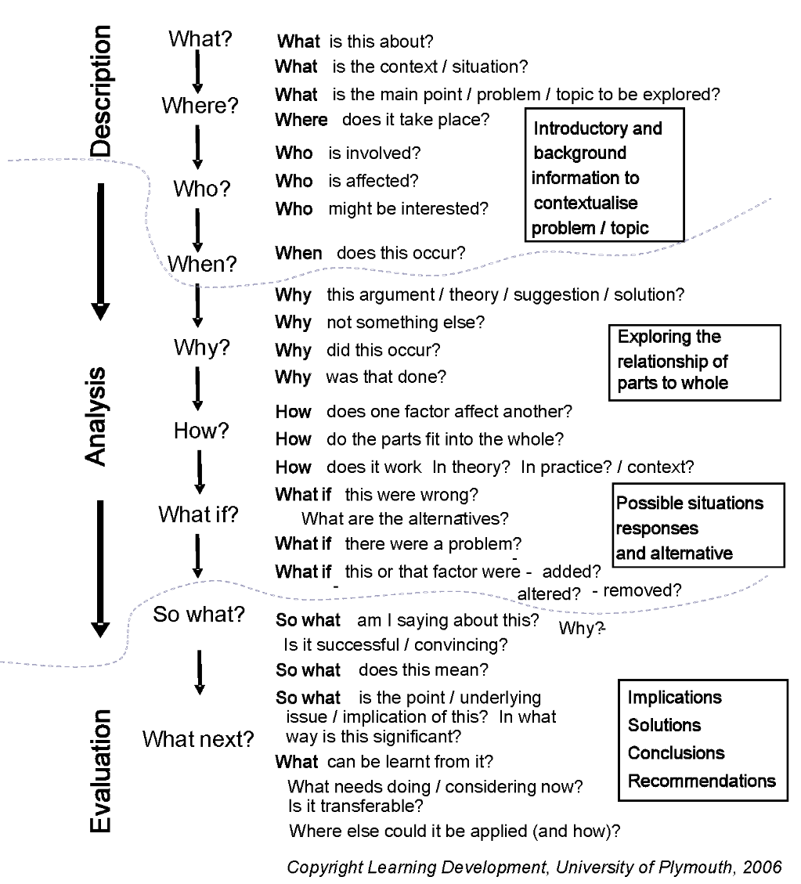
Notes:
This is a much more detailed example. Remember you don’t have to include every single one, as it might not be appropriate in your essay. Just be sure to include those that are relevant!
Also look at the details in the boxes in the slide, they have useful contextualised insights.
This is available on the Learning Development website in our guide on ‘Critical Thinking’ and also the ‘Model to generating critical Thinking’. Link (guides at bottom of the page): www.plymouth.ac.uk/learn

Slide 33
Sentence flow
Is this a good discussion?
Forsyth (2013, p.36) states that ’…others in the field of engineering should do the following…’ There is also a number of suggestions that engineering practice should be… (Jones, 2016). Jones (2016) also describes this initial process as having…and there are a number of things to consider… According to UK-SPEC (2015) it is required that engineers carryout… The guidelines also details certain aspect of practice required… (UK-SPEC, 2016). Jones (2016) touches on this by demonstrating…
NO! This is sentence after sentence of facts (only description)…
However, it is a good use of Harvard (‘in-text’ citations) referencing.
Notes:
While this is referenced correctly for a Harvard format, this is literally just a wall of detail…. Descriptive facts which will lead to poorer marks.

Slide 34
Sentence flow
‘Leaving aside the issue of structured training, normal daily physical activity is a neglected area. Daily exercise can…’
(Godfrey, 2013: 36)
Godfrey, J. (2013) The Student Phrase Book: Vocabulary for Writing at University. Palgrave Macmillan.

Slide 35
Paragraphs
Typically 5-7 sentences in length
Help break up the text
Makes it easier to read
Only use as a rough guide
The first sentence of the paragraph most important!
Helps with the flow

Slide 36
Making paragraphs flow
The first sentence should help the reader understand the direction of writing:
Continuation from the last paragraph
Or starting a new point
‘The previous paragraph outlined the main sources of automatic ageism. There are also several other more minor sources.’
(Godfrey, 2013: 36)
Godfrey, J. (2013) The Student Phrase Book: Vocabulary for Writing at University. Palgrave Macmillan.

Slide 37
Critical thinking
Discussion
Conclusions
Point 3
Point 4
Introduction
Point 1
Point 2
Critical thinking
Describe
Analyse
Evaluate
Notes:
The important part to remember is that each point includes critical thinking (Describe, Analyse, Evaluate) you may compare and contrast with other ideas or you may argue that a new approach is required.

Slide 38
Describe, Analyse and Evaluate
Looking at individual design stages for this engineering project, …it is particularly important… (UK-SPEC, 2016). According to engineering practice, this should always… (Matthews, 2015). Certainly UK-SPEC (2016) demonstrates many approaches to help avoid potential failures with certain designs…
However, to gain a better understanding of where poor design can lead to project failure, it is important to examine… …certainly engineers need to communicate clearly what… as also suggest by Adams (2006). Although, one major drawback of this approach is that… (UK-SPEC, 2016). In order to ensure that any design is…and performs as intended…, a new approach is required to overcome those issues… Brian (2016) provides a solution that would lead to better… This significantly…
Having considered all the important issues associated with engineering design practices, there is clear evidence that more needs to be done…, particularly… Making these changes would not only improve engineering practice, but it would also lead to further improvements in...resulting in fewer failures… It is therefore recommended that…
PLEASE NOTE: make sure the acronyms are explained
E.g. United Kingdom Standard for Professional Engineering Competence (UK-SPEC) – Add this to your glossary!
Notes:
This is a typical approach to critical thinking. Note that the description (before the first ‘however’) is very short. Description is literally just saying ‘What?’ is the main point about, keeping it short, then moving onto the analysis.
Analysis can start with words like ‘However’ (Why? Or How? Questions). Ultimately ensure that you use words that show you are analysing, not just adding more facts. You may find the Manchester Phrase Bank helpful in this respect: http://www.phrasebank.manchester.ac.uk/being-critical/ When on this website, please note the left hand menu for other phrases.
Finally, the icing on the cake, evaluate. ‘Having considered…’ (So What? Or What Next?) at this point you pull together the analysis, thus demonstrating to your tutor the intended direction or decision. This part may seem obvious, but if left out, you are not going to achieve better marks.
Note: Ensure that you reference new ideas or facts throughout. Sometimes this is also extended into the evaluation section, but be careful that it does not sounds like more analysis. References here can help reinforce a decision for a specific course of action base on the original analysis.

Slide 39
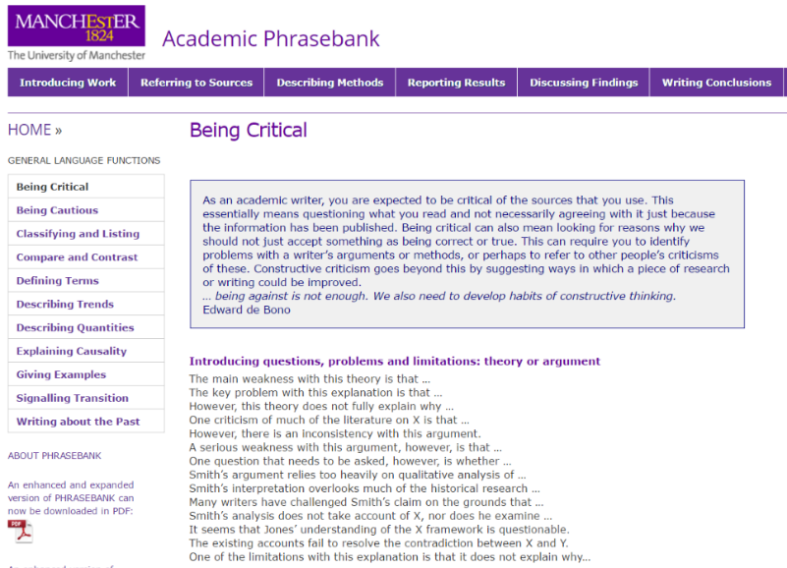
Writing with critical language
www.phrasebank.manchester.ac.uk
Manchester Phrase Bank
Note the left navigation menu:
Being Critical
Being Cautious
Classifying and Listing
Compare and Contrast
Defining Terms
Etc…
Notes:
The use of ‘however’ or ‘although’ are good words to demonstrate critical writing (analytical). However, there are times when you want use something different. In this respect the phrase bank is very good to help you construct your sentences to ensure you are sounding critical, or comparing and contrasting or being cautious about your critical views of the literature. You all have your own writing style, so some of these phrases may not be your preference. Pick and choose what you feel works for you.

Slide 40
Other examples
Other example reports or dissertations
What about journal articles? E.g.
A drone detection with aircraft classification based on a camera array https://iopscience.iop.org/article/10.1088/1757-899X/322/5/052005
Object Detection Technique for Small Unmanned Aerial Vehicle https://iopscience.iop.org/article/10.1088/1757-899X/260/1/012040
Be careful with journals, sometimes 1st person language is used!
Structures can vary (headings and sub-headings).

Slide 41
Making an argument?
Everyone clear on this?

Slide 42
Developing arguments
4. Implications
1. Controlling statement First sentence ‘controls’ the rest of the paragraph
State significance and link to next paragraph
3. Support
2. Justification
Theory and references: Evidence Case study Analysis
Unpack the controlling statement: Explain Analyse
Notes:
This is all about setting the scene for the argument – justifying your claims with supporting evidence. A claim is nothing without evidence to substantiate.
Don’t forget to explain the significance of those implications!

Slide 43
How to reference
Cite Them Right (book and also online) http://www.citethemrightonline.com.plymouth.idm.oclc.org/
Off campus
This link includes university authentication (bookmark for future reference)
Always check your assignment brief for preferred referencing format. The following example is the commonly used ‘Harvard’ format.
Notes:
References/arguments/discussions/opinions are liken to actors bringing their own views.
Don’t forget that you need to give credit to those ideas!

Slide 44
How to reference a book (example)
Be consistent with references and in text citations (Harvard):
In text citations:
(Johns, 2013, p. 25) or Johns (2013, p. 25)
Reference:
Johns, J.B. (2013) A guide to good electrical engineering. London: A publisher.
Notes:
References/arguments/discussions/opinions are liken to actors bringing their own views.
Don’t forget that you need to give credit to those ideas!

Slide 45
How to reference (journals)
More than three authors (Harvard):
In text citation:
(Jacobson et al., 2014) or Jacobson et al. (2014)
Reference:
Jacobson, R.J., Harrison, T., Ford, H., and Jones, P. (2014) ‘Good scientific practice: when does hypothesis really become theory?', Journal of Scientific Discovery, 33(3), pp. 323–326.
Notes:
References/arguments/discussions/opinions are liken to actors bringing their own views.
Don’t forget that you need to give credit to those ideas!
The examples here are fake references…

Slide 46
Reference list (Harvard: alphabetical order)
References
Adams, B. (2013) Troublesome knowledge, London: A publisher.
Hamill, L. (2011) Understanding Hydraulics. 3rd ed. Basingstoke: Palgrave.
Jacobson, R.J., Harrison, T., Ford, H., and Jones, P. (2014) ‘Good scientific practice: when does hypothesis really become theory?', Journal of Scientific Discovery, 33(3), pp. 323–326.
Johns, J.B. (2013) A guide to civil engineering practice, London: A publisher.
Vivoni, E.R. and Camilli, R. (2003) ‘Science and truth: are they really synonymous terms?’, Philosophy in science, 13(4), pp. 457-468.
Notes:
These references are all fake!
References/arguments/discussions/opinions are liken to actors bringing their own views.
Don’t forget that you need to give credit to those ideas!
The examples here are fake references…

Slide 47
References
Numbered format (see project guide for further details):
[1] Donnelly. T., “Time Delay Solenoid Switch Using VMOSFETS”, New Electronics, Vol. 19, No. 3, February, 1986.
[2] Donnelly. T., Harding. T., “High-Tech Application of the Remainder and Factor Theorems”, Teaching Mathematics and its Applications, Vol. 10, No. 4, The Institute of Mathematics and its Applications, pp 144-150, 1991.
Contents courtesy of Dr Paul Davey
Notes:
If, during the course of your project, you have used anything from another persons work you must give details.
For instance, you may have used a formula from a book or article or you may have cited a statement or theory.
You place a [number] immediately after using the item and give details in this section.
Don’t get the References section confused with the Bibliography section.

Slide 48
Bibliography
This is different to a reference list
The bibliography items are things you might have read, but not cited (referenced) in the main report
Highlights ‘useful’ additional reading
Demonstrates wider reading

Slide 49
Appendices
Appendices are not typically included in the word count!
Items you might consider:
Requirements List
Concept sketches and photos of prototypes (not needed in main body)
Drawings and other illustrations not appropriate for the main body of the text
Concept evaluation tables
Project milestone tables
Meetings
Sample code
Anything that would make the main body difficult to read
However….DO NOT use the appendices as a dumping ground!

Slide 50
Think about why you are writing
Planning:
The aim of my essay/report is to…
My argument will be valuable because…
My main points are… (Check the brief)
My conclusion will be…
My recommendations will be…

Slide 51
Summing up
Notes:
https://www.mentimeter.com/s/220e9e265e842988f55de0a0712de3d5/50044f0a1a02

Slide 52
Writing the first draft
Free writing maybe all you need to get started
Ensure you structure your writing appropriately
Decided on appropriate sub-heading or sections needed
Easier to establish the main structure earlier on
What is it that your tutor wants?
How can you achieve this?
Notes:
Ideas on how to approach your first draft, if you have already made a start on your assignment, then use these for future work.

Slide 53
Keep writing
Write regularly, 15-30 mins a day, to maintain momentum
Avoid over elaborate writing, be concise and to the point; being aware of linking phrases and flow
Proofread aloud and carefully to ensure proper language use and readability
Talk about your ideas and writing as much as you can with others
Read academic texts to see how they ‘sound’, follow the principles of their good practice

Slide 54
Report check list
What is the purpose of this report, and has it fulfilled that clearly?
Are your ideas presented logically?
Is there enough information, is the information included accurate?
Does the report cover all the key points?
Do you analyse your evidence/data?
Data & information → conclusions → recommendations?
Language, tone and style clear, direct and formal?
Is the grammar, punctuation and spelling correct?
Is the layout simple, clear, logical and consistent?
Clear, useful figures and tables, integrated and referenced?
Appropriate range of sources? Acknowledged properly?
Should there be a glossary? If there is one, is it comprehensive?
Are the appendices clearly labelled and signposted?
Have you left it for a while, gone back and reviewed it?
(adapted from Burns and Sinfield, 2008)
Notes:
I’m not going through this in the session, however, you may find this checklist helpful.

Slide 55


Feedback on Jason’s workshop
bit.ly/3iuuDoo
Enter in web browser

Slide 56

Questions?

